Slide 1
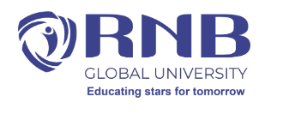
Course Name: Operating System
Course Code: 13005100
Introduction of operating System
Unit-1
Presented By: Ms. Sonam Pareek
Assistant Professor

Slide 2
Course Objectives
To Understand the services provided by an operating system.
1. To acquire the fundamental knowledge of the operating system architecture and its components
2. To know the various operations performed by the operating system.
3. The Operating System will identify at which Time the CPU will perform which Operation and in which Time the Memory is used by which Programs.
4. Operating System Also Known as the Resource Manager Means Operating System will Manages all the Resources those are Attached to the System means all the Resource like Memory and Processor and all the Input output Devices those are Attached to the System

Slide 3
Operating System
An Operating System (OS) is an interface between a computer user and computer hardware.
An operating system is a software which performs all the basic tasks like file management, memory management, process management, handling input and output, and controlling peripheral devices such as disk drives and printers.

Slide 4
Definition
An operating system is a program that acts as an interface between the user and the computer hardware and controls the execution of all kinds of programs.

Slide 5
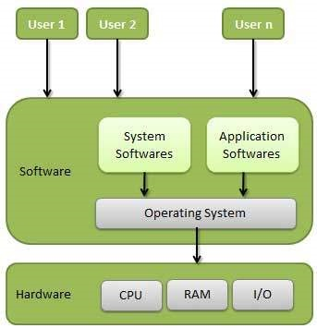

Slide 6
Some popular Operating Systems include Linux Operating System, Windows Operating System, etc.

Slide 7
Following are some of important functions of an operating System.
Memory Management
Processor Management
Device Management
File Management
Security
Control over system performance
Job accounting
Error detecting aids
Coordination between other software and users

Slide 8
Applications of Operating System
Following are some of the important activities that an Operating System performs −
Security − By means of password and similar other techniques, it prevents unauthorized access to programs and data.
Control over system performance − Recording delays between request for a service and response from the system.
Job accounting − Keeping track of time and resources used by various jobs and users.
Error detecting aids − Production of dumps, traces, error messages, and other debugging and error detecting aids.
Coordination between other softwares and users − Coordination and assignment of compilers, interpreters, assemblers and other software to the various users of the computer systems.

Slide 9
Fundamentals of Operating System

Slide 10
Operating System Services
Ensures efficient operation of system
Users / System Programs
User Interface
Program Execution
I/O Operations
File System Manipulation
Communications
Error Detection
Resource Allocation
Accounting
Protection & Security
Notes:
Galvin- pg 49
Os provides an environment for the execution of programs
It provides certain services to programs and to the users of those programs
The services provided by os can be categorized in 2 types
1. helpful for Users/ other system program running on the system
2. efficient operations of the system itself.
Specific services provided differ from one os to another (but there are some common services)

Slide 11
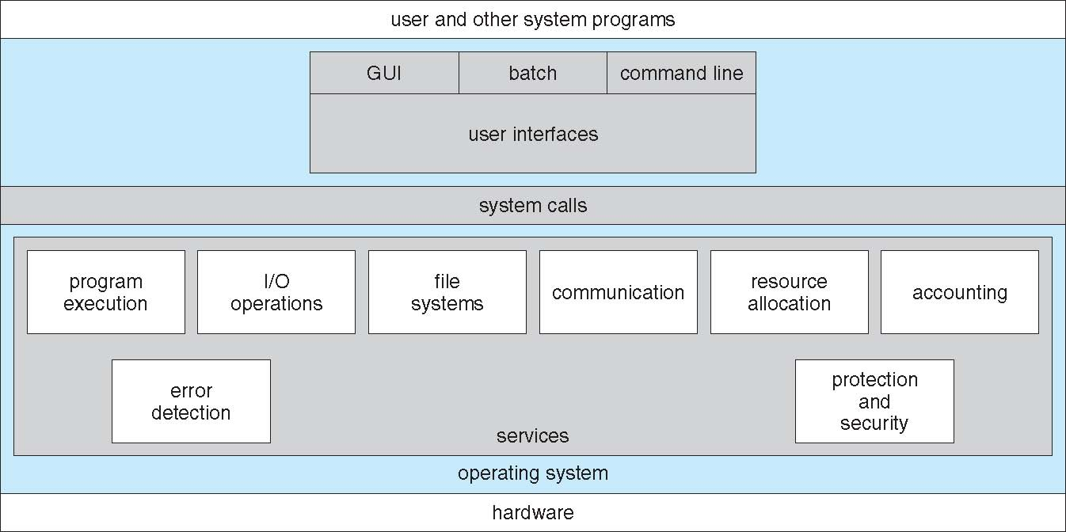
View of operating system services
Notes:
Through user interface system calls are made to access the services of OS.

Slide 12
Operating System Services
  User Interface
    Command line interface
    Batch Interface
    GUI
  Program execution
    System capability to load a program into memory and to run it.
Notes:
User Interface
Command line interface – use text commands & methods for entering them.
Batch Interface – commands & directives are stored in file & those files are executed.
GUI – window system with pointing device to direct I/O & select from menus.
→ almost all OS have user interface which can take several forms
→ directives control the commands.
→ pointing devices like mouse, joystick etc. to perform I/O operation OR select option from menu.
2→ Program execution related service helps in loading programs into memory & executing those programs

Slide 13
Operating System Services
  I / O Operations
    For efficiency & protection, users usually can’t control I/O devices directly. Therefore, OS must provide means to do so.
  Resource allocation
    Allocating resources to multiple users/ jobs running at the same time.

Slide 14
Operating System Services
  File System Manipulation
    Enable programs to read, write, create and delete files.
  Error Detection
    Ensure correct computing by detecting errors in the CPU and memory hardware, in I/O devices, or in user programs.
Notes:
3→A running program may require I/O from a file or any i/o device.

Slide 15
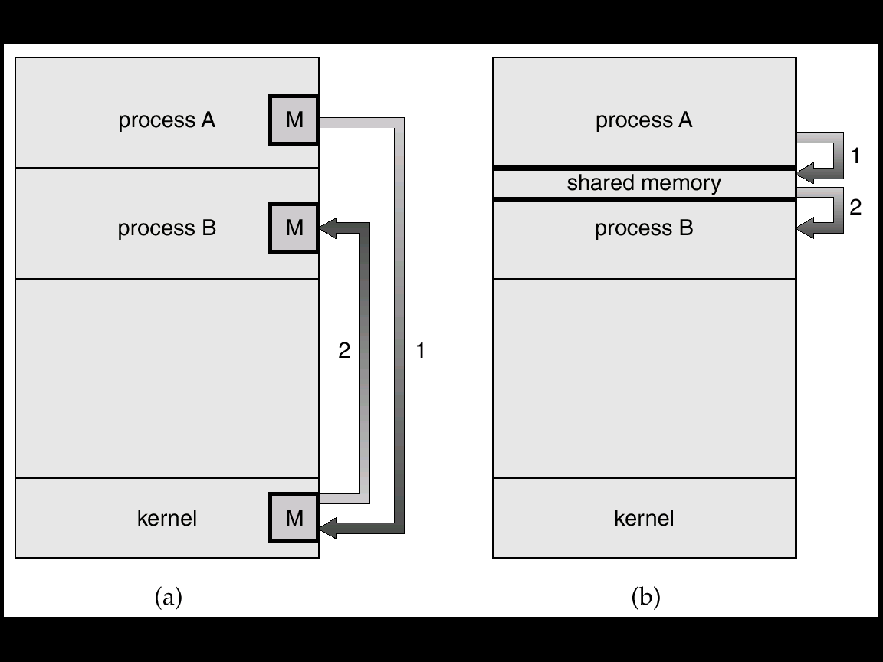
Communications
    Exchange of information between processes executing either on the same computer or on different systems tied together by a network.
    Implemented via shared memory or message passing.
Message
Passing
Shared
Memory
Notes:
There are many situations in which processes that are running in the system needs to communicate with each other. These processes communicates by exchanging information with each other.
Such communication can take place between the processes executing on same computer or on different computers. This communication can be implemented in 2 ways :
Message passing & Shared memory

Slide 16
Operating System Services
  Accounting
    Keep track and record which users use how much and what kinds of computer resources.
    Can be used for account billing or for accumulating usage statistics.
  Protection & Security
    Ensuring that all access to system resources is controlled.
    Password to gain access to system resources.
Notes:
Additional functions exist not for helping the user, but rather for ensuring efficient system operations.

Slide 17
Structure of an Operating system
Internal structure of different Operating Systems can vary widely depending on goals and specifications
Affected by choice of hardware, type of system User goals and System goals
User goals
    operating system should be convenient to use, easy to learn, reliable, safe, and fast
System goals
    operating system should be easy to design, implement, and maintain, as well as flexible, reliable, error-free, and efficient
Notes:
Ekta – 49
OS comprises of kernel, command processor, shell, user interface.

Slide 18
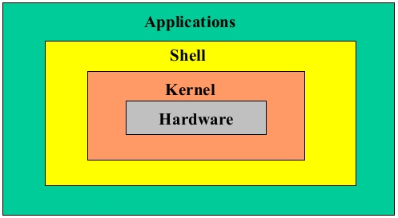
Layered Approach
The operating system is divided into a number of layers (levels), each built on top of lower layers.
The bottom layer is the hardware; the highest is the user interface.
With modularity, layers are selected such that each layer uses functions (operations) and services of only lower level layers

Slide 19
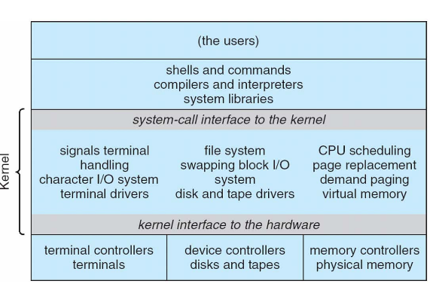
Applications
User
Mode
Standard Libs
Kernel
Mode
Hardware
Notes:
The System Utilities consist of various system interrupts and system calls which is to transfer the control for the user mode to the kernel mode containing the kernel and shell for further execution of the commands. The control can be transfer using System calls.
System Call
System call is an interface between a process and the operating system. In simple words the system call is the request for running any program and for performing any operation on the system that the user has requested
eg. A user has requested to MS paint. This request will be sent to the operating system, and then the operating system will generate some activity to support MS paint and run on the system.
System calls are of different types
File Management System call – For performing open, close, read, write etc operations.
Process Control System Call – For performing Load,execute,create etc operations.
Device Management System Call – For performing request device,write device,release device etc operations.
Communication System call – For performing Send message,transfer status etc operations etc.
User applications - these the application which a user require to perform its task. Linux and other operating system come up which various different application in it like g++, gcc, office suits etc .Kernel is used to generate processes to support these these applications.

Slide 20
Kernel
    Core part of the operating system, responsible for all the major activities of the OS.
    Consists of different modules like task and memory management and interacts directly with the underlying hardware.
    It act as an interface between operating system and other hardware resources.
Notes:
The kernel offers the required abstraction to hide application programs or low-level hardware details to the system. It act as an interface between operating system and other hardware resources. It is the main part of the operating system that loads firsts and remains in the main memory. It is the bridge between the application and the actual data processing to support the application. It is responsible for task management, memory management and disk management .Its primary function is to manage the computer resources and support other program who want to use these resources
Shell - It is the part of the operating system which receives and executes the operating system command by the user. The commands are then send to the kernel for execution. If the command is valid the kernal starts the execution else error will be produced. When user give command for performing any operation the request goes to the SHELL. The Shell then translates these human program to machine language and then transfer the request to the kernel. The kernel receives the request from shell, processes the request and then displays the result on the screen. All these functions are performed by the kernel in a transparent manner.
You should understand that the shell is just a program, meaning it's not a tightly integrated component of the UNIX operating system. For this reason, users can select what shell they want to use (have loaded) when working on UNIX systems. Two powerful and frequently used shells, which use very similar syntax, are the Korn and BASH shells. Korn is more typically used on systems running UNIX and the BASH shell is the default on systems running Linux, which is an operating system that is very similar to UNIX.
Korn shell
Bourne shell
C shell
POSIX shell

Slide 21
Shell
    Command line interpreter that translates the command user types in so that the computer will understand and perform the desired operation.
    Interface between user and the operating system.
    Command line/ GUI

Slide 22
    When user give command for performing any operation the request goes to the SHELL.
    The Shell then translates these human program to machine language and then transfer the request to the kernel.
    The kernel receives the request from shell, processes the request and then displays the result on the screen.
    All these functions are performed by the kernel in a transparent manner.

Slide 23
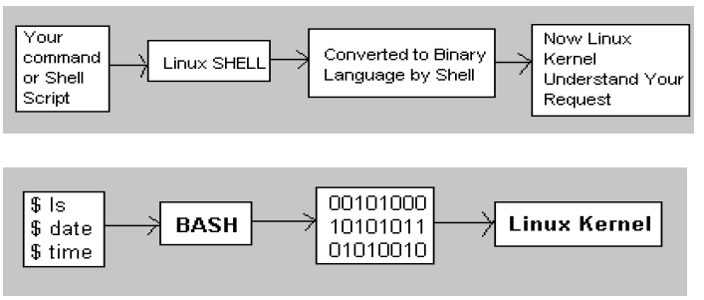

Slide 24
Evolution of OS
Serial Processing
Batch Processing
Multiprogramming
Multiprocessing
Time sharing
Distributed processing
Real time systems
Notes:
Serial Processing
Network Operating system
Personal computer system
Real time system

Slide 25
Serial Processing
Programmer interacted directly with computer hardware. Users reserve time slots and during that period they occupy the computer exclusively.
Machine called bare machine as they don't have full fledged OS.
Programs in machine language.
Uses Punch Card, paper tapes and language translator
Machines run from a console with display lights, toggle switches, input device, and printer.
Disadvantages - Scheduling , Set up time
Notes:
Programs in machine code were input through input device (card reader)/ errors indicated through lights
These system presented two major problems.
1. Scheduling
2. Set up time:
Scheduling:
Used sign up sheet to reserve machine time. A user may sign up for an hour but finishes his job in 45
minutes. This would result in wasted computer idle time, also the user might run into the problem not
finish his job in alloted time.
Set up time:
A single program involves:
●
Loading compiler and source program in memory
●
Saving the compiled program (object code)
●
Loading and linking together object program and common function
Each of these steps involves the mounting or dismounting tapes on setting up punch cards. If an error
occur user had to go the beginning of the set up sequence. Thus, a considerable amount of time is spent
in setting up the program to run.
Only one job is done at a time and only on the completion of that job the other job starts
In serial processing the CPU gets the info, analyze it, process it, send it as output and all these functions are done in a sequential manner
i.e., Machines run from a console with display lights, toggle switches, input device, and printer. Setup included loading the compiler and source program, saving compiled program, loading and linking
Schedule time, e.g. sign up

Slide 26
Batch Processing
Early computers were expensive, so it was important to maximize processor utilization.
Batch - group of jobs with similar needs.
Programmer would write program(job) and submit it on cards or tape to the operator , who batches the jobs together sequentially and places the entire batch on an input device.
Computer executes each batch sequentially, processing all jobs of a batch considering them as a single process called batch processing.
To speed up the processing operator batch together jobs with similar needs.
Role of OS was to transfer control from one job to another.
Notes:
Ekta-6, Madhu slides, godbole
First rudimentary operating system.
Wasted time due to scheduling and setup time in Serial Processing was unacceptable.
To improve utilization, concept of a batch operating system was developed.
The central idea behind the simple batch-processing scheme is the use of a piece of software known as the monitor. With this type of OS, the user no longer has direct access to the processor. Instead, the user submits the job on cards or tape to a computer operator, who batches the jobs together sequentially and places the entire batch on an input device, for use by the monitor. Each program is constructed to branch back to the monitor when it completes processing, at which point the monitor automatically
begins loading the next program.

Slide 27
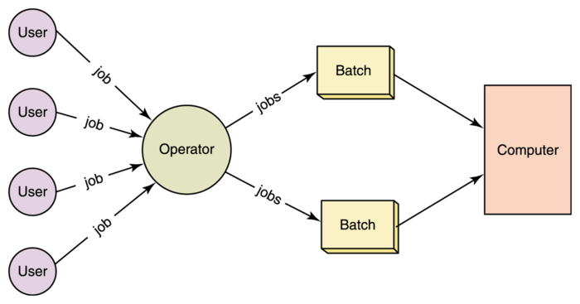
Notes:
All cobol programs together, basic together in one batch
Job Control Language – JCL -Special type of programming language used to provide instructions to the monitor, what compiler to use, what data to use

Slide 28
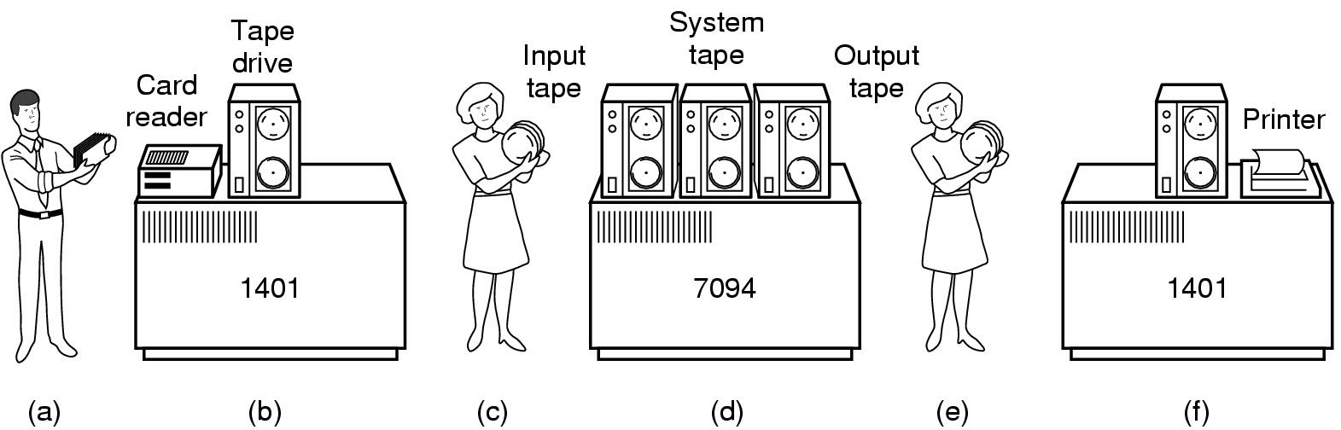
Early batch system
  bring cards to 1401
  read cards to tape
  put tape on 7094 which does computing
  put tape on 1401 which prints output
Notes:
bring cards to 1401
read cards to tape
put tape on 7094 which does computing
put tape on 1401 which prints output

Slide 29
Batch Processing
Disadvantage
    Less user interaction; difficult to debug
    Not possible to take user input in between
    More job set up time
    CPU remain idle during transition
    Speed mismatch(CPU & I/O dev)
  Buffering & Spooling was used to improve CPU Utilization further.
Notes:
Here are some advantages of batch systems:-
Repeated jobs are done fast in batch systems without user interaction.
You don’t need special hardware and system support to input data in batch systems.
Best for large organizations but small organizations can also benefit from it.
Batch systems can work offline so it makes less stress on processor.
Processor consumes good time while processing that mean it knows which job to process next. In real time systems we don’t have expectation time of how long the job is and what is estimated time to complete it. But in batch systems the processor knows how long the job is as it is queued.
Sharing of batch system for multiple users.
The idle time batch system is very less.
You can assign specific time for the batch jobs so when the computer is idle it starts processing the batch jobs i.e. at night or any free time.
The batch systems can manage large repeated work easily.
Disadvantages of batch processing systems
Computer operators must be trained for using batch systems.
It is difficult to debug batch systems.
Batch systems are sometime costly.
If some job takes too much time i.e. if error occurs in job then other jobs will wait for unknown time.

Slide 30
Buffering
Buffer is a temporary storage area of main memory for holding data during input & output data transfers.
It stores data while they are transferred between two devices or between a device and an application.
Overlaps the I/O of job with that of its own computation
Notes:
http://www.slideshare.net/myrajendra/5-spooling-and-buffering
After the data have been read and the CPU is about to start the operation, the input device is instructed to begin the next input operation
Both the CPU and I/O device are busy
By the time CPU is ready for next operation, the input device would have finished reading it
CPU creates data and puts into a buffer until an output device can accept it
2nd reason example→ Device1 transfers 16 bits at a time but device2 can receive only 8 bits at a time.

Slide 31
Buffering
Reasons for Buffering :
    To cope up with speed mismatch between the producer and consumer of a data stream.
    To adapt between devices that have different data transfer sizes.
    To support copy semantics for application I/O
Notes:
Copy semantics - to support “copy semantics” for I/O write operations write single version of data (no mixing of old and new data can happen) - For example, when an application makes a request for a disk write, the data is copied from the user's memory area into a kernel buffer. Now the application can change their copy of the data, but the data which eventually gets written out to disk should be the version of the data at the time the write request was made.
http://www.slideshare.net/myrajendra/5-spooling-and-buffering
After the data have been read and the CPU is about to start the operation, the input device is instructed to begin the next input operation
Both the CPU and I/O device are busy
By the time CPU is ready for next operation, the input device would have finished reading it
CPU creates data and puts into a buffer until an output device can accept it
2nd reason example→ Device1 transfers 16 bits at a time but device2 can receive only 8 bits at a time.

Slide 32
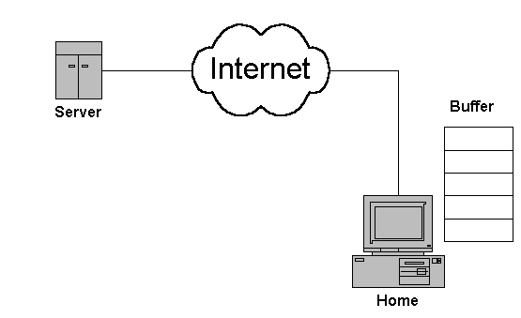
Notes:
The Input/Output Model
When you type on a keyboard, you're using an input device. When the letters you type appear on the screen, the screen is an output device. In many operating systems, text appearing in a terminal window is called "standard output." Standard output isn't buffered by default. The reason for this is that nobody really wants to type out everything and not see it for a few seconds; if you experience this when typing in a program, you'll rightly be convinced that something is wrong.
Spooling
Spooling's name comes from the acronym for Simultaneous Peripheral Operation On-Line (SPOOL). Spooling waits until the entire operation is done before sending it to the output device or a network, and your likeliest encounter with spooling probably comes from sending a document to a printer. If you've ever wondered why there's a delay between when you press "Print" and a document coming out of the printer, spooling is why – the computer processes the entire print job into a format the printer can handle and sends it down the serial bus to the printer. Spooling is also used for sending and receiving email.
Buffering
Spooling is great for some sorts of computer tasks, but it's not appropriate for others. Watching video on YouTube comes with the expectation that clicking "Play" will cause the video to begin playing immediately. For this to work, the website sends small parts of the video when the page loads, and then starts sending the next parts of the video when the "Play" button is clicked. These subsequent parts are queued up in a buffer so that the video plays smoothly even though it's not fully downloaded when you start it.
Preloading data into a reserved area of memory (the buffer).
It temporarily stores input or output data in an attempt to better match the speeds of two devices such as a fast CPU and a slow disk drive.
Buffer may be used in between when moving data between two processes within a computer. Data is stored in buffer as it is retrieved from one processes or just before it is sent to another process.
With spooling, the disk is used as a very large buffer. Usually complete jobs are queued on disk to be completed later.
It is mostly used for input, output, and sometimes temporary storage of data either when transfer of data takes place or data that may be modified in a non-sequential manner.

Slide 33
Spooling (Simultaneous Peripheral Operation On-line)
Like buffer, spooling is used in order to overcome the problem of speed mismatch
A spool is a buffer that holds output for a device, such as a printer, that cannot accept interleaved data streams
With spooling, the disk is used as a very large buffer. Usually complete jobs are queued on disk to be completed later. Ex. Spooling for printer
Spooling overlaps input of one job with the computation of other jobs i.e. the spooler may be reading the input of one job while printing the output of a different job.
Notes:
Update the slide from http://www.tutorialspoint.com/operating_system/os_properties.htm
Interleave = interrupt
It Overlap I/O of one job with computation of another job.
It maintains the Job pool – data structure that allows the OS to select which job to run next in order to increase CPU utilization.
E.g: Print spooling and Mail spools etc. When there is a resource (like printer) to be accessed by two or more processes(or devices), there spooling comes handy to schedule the tasks. Data from each process is put on the spool (print queue) and processed in FIFO(first in first out) manner. With spooling all process can access the resource without waiting. After writing the data on spool, process can perform other tasks. And printing process operates seperately. Without spooling, process would be tied up until the printing finished. Spooling is useful for the devices which have differing data access rate. Used mainly when processes share some resource and needed to have synchronization.

Slide 34
Spooling Advantages
Performance of the system is increased
CPU & I/O devices work efficiently
Also used for processing data at remote sites

Slide 35
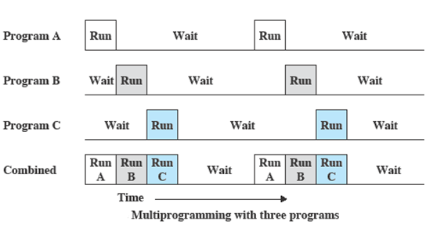
Multiprogramming

Slide 36
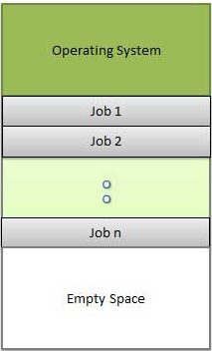
Multiprogramming
Allows multiple processes to reside in main memory ready to execute.
Only one program at a time gets the CPU for execution while others are waiting their turn.
The running program keeps executing until it blocks for I/O and the next program in line takes the turn for execution.
Goal is to optimize CPU utilization by reducing CPU idle time.
Not used any more
Notes:
Example of multiprogramming, we open word, excel, access and other applications together but while we type in word other applications such as excel and access are just present in main memory but they are not performing any task or work. Or we can say that are not being used at the same time.

Slide 37
Example of multiprogramming, we open word, excel, access and other applications together but while we type in word other applications such as excel and access are just present in main memory but they are not performing any task or work. Or we can say that are not being used at the same time.
Throughput - The total number of processes that complete their execution per time unit. OR Time required to complete the execution of all the processes.

Slide 38
Multiprogramming
Advantages
    High CPU Utilization
    Increased throughput and lower response time.
Disadvantage
    Doesn't guarantee timely completion of a program. If very first process runs for hours without needing any I/O, other processes will keep waiting.
    Need larger memory hence memory management also required.
    Proper memory protection mechanism required.
    Job scheduling - the processor must decide which process to run.
Notes:
Finally, note that if there are N ready processes and all of those are highly CPU-bound (i.e., they mostly execute CPU tasks and none or very few I/O operations), in the very worst case one program might wait all the other N-1 ones to complete before executing.
Since multiple programs resides in memory .. So need large memory…. Secondary storage is used for this purpose.
Unauthorized access to data of one program by other program should be avoided. So proper memory protection mechanism requires
Example of multiprogramming, we open word, excel, access and other applications together but while we type in word other applications such as excel and access are just present in main memory but they are not performing any task or work. Or we can say that are not being used at the same time.
Program status preservation.
Proper job mix (I/O bound and CPU bound)
Throughput - The total number of processes that complete their execution per time unit. OR Time required to complete the execution of all the processes.
Logical parallelism –
Appears that many programs are allotted CPU almost simultaneously.

Slide 39
Time Sharing
A logical extension of multiprogramming.
Time sharing is done to share a high performance computer among several users (or batch jobs) at the same time.
Each user (job) have a brief share of CPU time (time slot or quantum ).
In Multiprogramming, one program keeps running until it blocks however in a time sharing system each running process takes only a fair amount of the CPU time called quantum time.
Goal is to minimize response time.
Response time of a properly designed system similar to dedicated system.
Notes:
Processor time is shared among multiple users
Multiple users simultaneously access the system through terminals, with the OS interleaving the execution of each user program in a short burst or quantum of computation
given the relatively slow human reaction time, the response time on a properly designed system should be similar to that on a dedicated computer.
It allow several user to run several task concurrently on processor by having several dumb terminals.
Each user is provided with its own terminal (combination of keyboard and display screen--- processing is not done on terminal
)connected to the main computer system.
Each user have a brief share of CPU time (time slot or quantum ).
It gives an illusion that each user is getting full attention of CPU.

Slide 40
Time Sharing
Single user
    Multiple processes running on one system
Multi user
    It allow several user to run several task concurrently on processor by having several dumb terminals.
    Each user is provided with its own terminal connected to the main computer system.
    Each user have a brief share of CPU time (time slot or quantum).
    Gives an illusion that each user is getting full attention of CPU.

Slide 41
Time Sharing
  Advantages
    Provide advantage of quick response
    Avoids duplication of software
    Reduces CPU idle time
  Disadvantages
    Security and integrity of user programs and data
    With the increase in no. of user process, throughput get effected
Notes:
Problem of reliability. → 1. in case of preemptive scheduling process can stay starved in queue for resources
→ 2. If that one CPU fails then entire system will get halted.

Slide 42
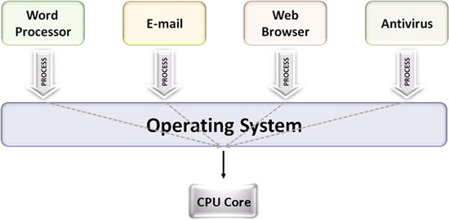
Multi Tasking
Multiple (programs, processes, tasks, threads) running at the same time.
Also known as time sharing.
Might use time sharing, multithreading, multi processing to implement.
Notes:
One process is divided into subtasks
Example of multitasking, we listen to music and do internet browsing at the same time (they execute in parallel).
The concept of multitasking is quite similar to multiprogramming but difference is that the switching between jobs occurs so frequently that the users can interact with each program while it is running. This concept is also known as time-sharing systems. In multiprogramming, no user interaction happens in between.
Multitasking refers to term where multiple jobs are executed by the CPU simultaneously by switching between them.
Switches occur so frequently that the users may interact with each program while it is running.

Slide 43
Multiprocessing (Parallel Systems)
Multiprocessor systems have more than one CPU in close communication.
Tightly coupled system – processors share memory and a clock; communication usually takes place through the shared memory.
All processors can perform the same functions or different ones
They are commonly used for scientific applications
Notes:
Galvin - 13

Slide 44
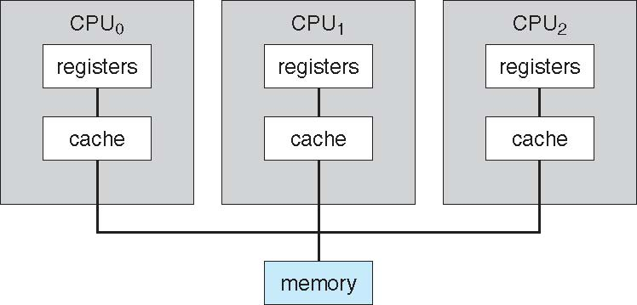
Printer

Slide 45
Multiprocessing
  Advantages
  Increased throughput – more work done in less time.
  Economical (can share peripherals, mass storage, and power supplies)
  Increased reliability – failure of one processor will not halt the system.
  Fault tolerance (graceful degradation) – one system suffer a failure of any single component still continue operation.

Slide 46
Types of Multiprocessing
  Asymmetric multiprocessing
  Symmetric multiprocessing (SMP)

Slide 47
  Asymmetric Multiprocessing
CPU 1
  Master-slave relationship.
  Each processor is assigned a specific task; master processor schedules and allocates work to slave processors.
  Supports multiple systems manufactured by different vendors on network
  More common in extremely large systems – SunOS Version 4
CPU 2
CPU 3
CPU 4

Slide 48
  Symmetric Multiprocessing (SMP)
  Each processor runs an identical copy of the operating system.
  All processors are peers – no master-slave relationship.
  Most modern operating systems support SMP.(e.g. – Solaris, Linux, windows)
CPU 1
CPU 2
CPU 4
CPU 3
Notes:
Soalries- commercial version of Unix designed by sun Microsystems

Slide 49
Distributed System
A distributed system is a collection of physically separate, possibly heterogeneous computer systems that are networked to provide the users with access to the various resources that the system maintains.
Distribute the computation among several physical processors.
Loosely coupled system – each processor has its own local memory; processors communicate with one another through various communications lines, such as high-speed buses or telephone lines.
Notes:
Galvin ppt + pg 30
Multiprocessing – Tightly coupled systems---shares the memory & clock

Slide 50
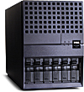
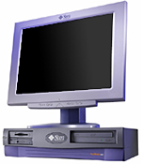




Distributed System
A collection of independent computers that appears to its users as a single coherent system.
Internet
** Distributed systems different than regular networks
Notes:
What role of OS - Access Transparency, Location Transparency, Replication Transparency, Failure Transparency, Migration Transparency, Concurrency Transparency, Performance Transparency, Scaling Transparency - heterogeneity

Slide 51
Distributed System
Delhi
Local Branch
Pune
Mumbai
Chennai
B’lore
Customer
in Pune
Head Office
Access Head
Office
Local Branch
Local Branch
Bangalore
Local Data
B’lore Customer
Local Branch
Notes:
Ekta – 14
Bank is having its branches all over India & its head office in Chennai. Assume that bank maintains local data at local branch & copy of data of all branches at Chennai, i .e. data is distributed throughout the country. This system facilitates the query processing for local customers of a branch & also for global customers (one who moved from B’lore tp Pune)
→Thus, Distr. Proc. is a form of online processing that allows single transaction to be composed of application program that access one or more databases on one or more computers across the network.

Slide 52
Distributed System
  Advantages
  Resources Sharing
  Computation speed up – load sharing
  Reliability
  Communications
Notes:
Requires networking infrastructure.
Local area networks (LAN) or Wide area networks (WAN)
May be either client-server or peer-to-peer systems.

Slide 53
Real Time Systems
Any computer system where the correct behavior of the system depends not only on the result of its computations, but also on the time at which the results are produced.
Well-defined fixed-time constraints , i.e. processing must be done within the defined time limit otherwise the system will fail.
Aim: minimize response time.
Real-time systems require timely response to events
  even under failure conditions
  even under extreme load conditions
Notes:
Well-defined fixed-time constraints , i.e.. processing must be done within the defined time limit otherwise the system will fail.
Deterministic
Worst case execution time of each of the system calls is calculable

Slide 54
Features of RTOS
  Fault tolerant
  Predictable performance under peak load
  Deterministic (Worst case execution time of each of the system calls is calculable)
Applications:
  System that controls scientific experiments
  Display system (airplane display screen)
  Robotics
  Traffic control systems
  Industrial control systems
  Medical imaging systems
Notes:
Deterministic
Worst case execution time of each of the system calls is calculable

Slide 55
THANK YOU

